Slide 1
LESSON 2.1
Ionization Energy

Slide 2
LESSON GOALS
I can state correct electron configurations (either full or condensed) for atoms or ions up to Z = 36
I can explain the trends and discontinuities in first ionization energy (IE) across a period and down a group
I can calculate the value of the first IE from spectral data that gives the wavelength or frequency of the convergence limit
I can deduce the group of an element from its successive ionization data

Slide 3
TASK 1: REVIEW (SHOULD DO)
Individually or with a partner:
If you need to review the quantum model of the atom or electron configurations, watch the appropriate videos from this YouTube Playlist

Slide 4
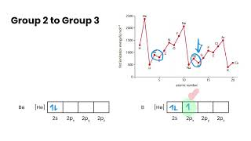
TASK 2: LEARN (MUST DO)
Individually:
Watch the Ionization Energy video
Complete the appropriate section of the guided note

Slide 5
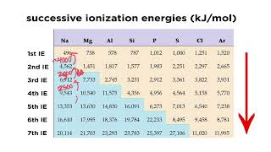
TASK 3: LEARN (MUST DO)
Individually:
Watch the Successive Ionization Energies video
Complete the appropriate section of the guided note

Slide 6
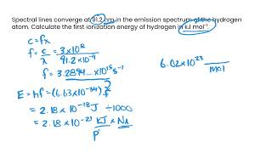
TASK 4: LEARN (MUST DO)
Watch the Calculating First Ionization Energies video
Complete the appropriate section of the guided note

Slide 7
TASK 5: PRACTICE
Individually or with a partner:
Complete the Ionization Energy practice (answers included)
Note: There are must do, should do, and aspire to do questions included in this practice!

Slide 8
TASK 6: MASTERY CHECK (MUST DO)
Individually:
Complete the Ionization Energy mastery check (see me when you are ready!)

